Slide 1
Enable Search on category values in Refine Panel
How-To

Slide 2
TABLE OF CONTENTS
Technical Consideration
How-To
This is the section name
This is the section name
This is the section name
This is the section name

Slide 3
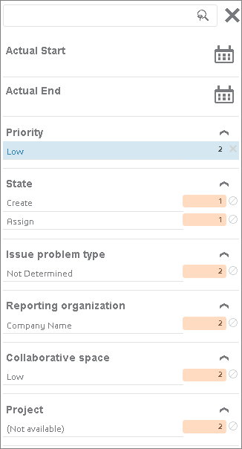
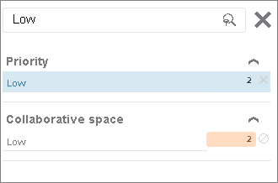
Enable Search on category values in Refine Panel
Technical Consideration
In the Refine Panel, the « Search Filters » box allows users to search for any specific facet value.
This value can be displayed in the view or not displayed because of a paginated list.
This behavior is possible using Suggest dictionaries

Slide 4
TABLE OF CONTENTS
Technical Consideration
How-To
This is the section name
This is the section name
This is the section name
This is the section name

Slide 5
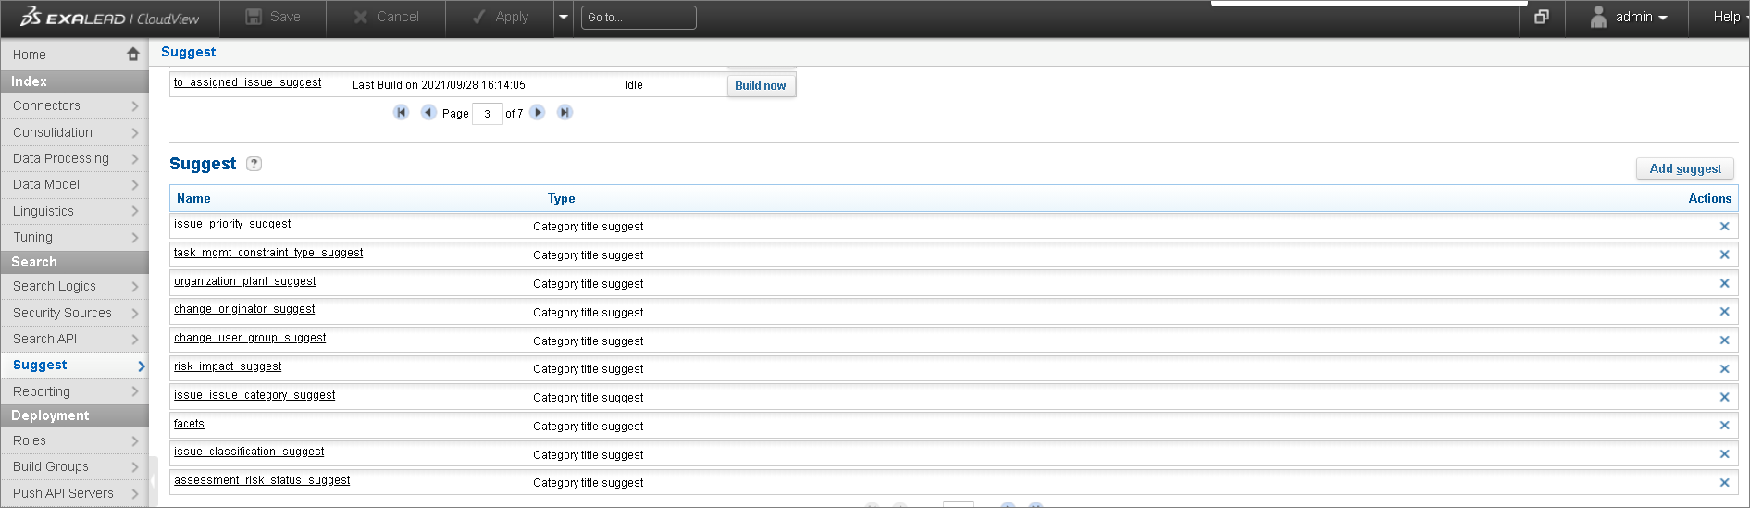
Enable Search on category values in Refine Panel
How-To – Add a suggest for facet attributes
For any of the facet properties you have in your Refine, you have to create a suggest entry.
In the Admin Console, go to Search/Suggest and click on ‘Add Suggest’

Slide 6
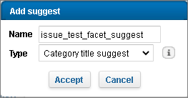
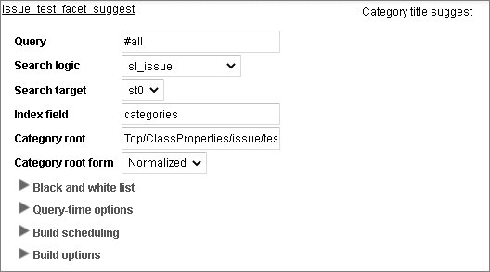
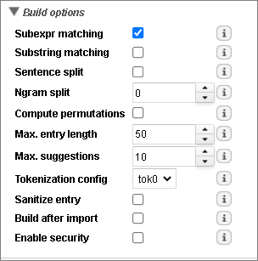
Enable Search on category values in Refine Panel
How-To – Add a suggest for facet attributes
Add suggest with type ‘Category title suggest’ and click ‘Accept’
Define the following information
  Query => #all
  Search Logic => select the search logic of your facet
  Search Target => st0
  Index field => categories
  Category root => select the facet you want to add suggest
  Category root form => Normalized
In the Build Options section
  Select ‘Subexpr matching’ option
  Leave default options for other parameters
In other sections, leave all options at default values

Slide 7
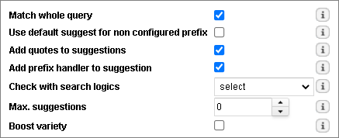
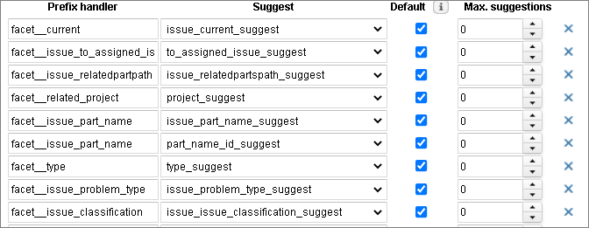
Enable Search on category values in Refine Panel
How-To – Add a dispatcher gathering all the facet attribute suggests
A dispatcher is used to gather all the facet attribute suggests that are used in the ‘Refine Panel’
In the Admin Console, go to Search/Suggest and click on ‘Add Dispatcher’
Set dispatcher name and click ‘Accept’
Define the information as described in screen shot
Add the suggest in the dispatcher with the following rules
  Prefix Handler : ‘facet__’ + name of the fully qualified facet
    Example : facet__issue_problem_type for ‘problem_type’ attribute of class ‘issue’
  Suggest : select the facet related suggest
  Default : selected
  Max Suggestions : 0

Slide 8
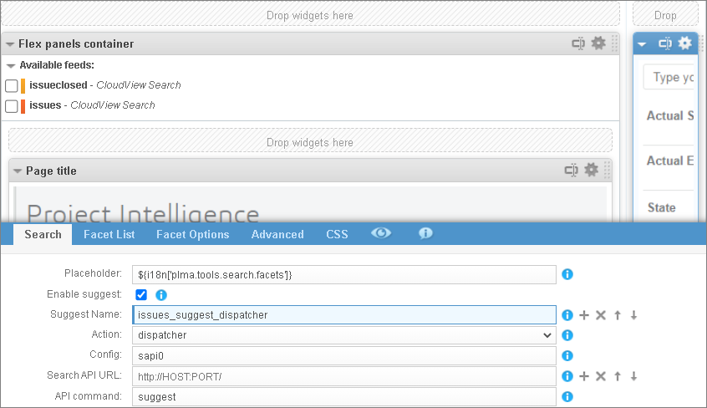
Enable Search on category values in Refine Panel
How-To – Define the dispatcher in the Refine Panel
At Refine Panel level, you have to configure the dispatcher for enabling search on category values

Slide 9
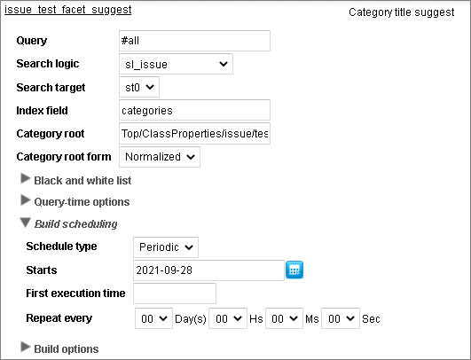
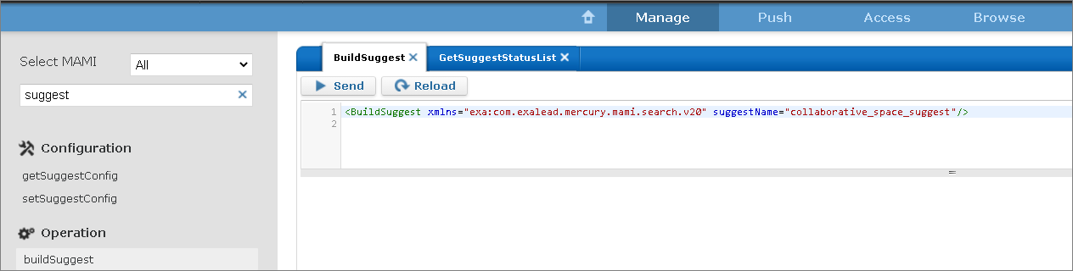
Enable Search on category values in Refine Panel
How-To – Schedule suggest build
At Suggest level, you can specify suggest build in the ‘Build scheduling’
Suggest Bulding can also be launched using the buildSuggest operation

